Slide 1

Impact of Covid 19 on retail & e-commerce In Canada

Slide 2
Questions
1. How has the COVID-19 pandemic affected the performance of e-commerce compared to traditional brick-and-mortar retail?
2. What are the long-term implications for consumer behavior in the retail industry?
3. What were the most and least pandemic sensitive industry?
4. API: Retail sales according to provinces in Canada

Slide 3
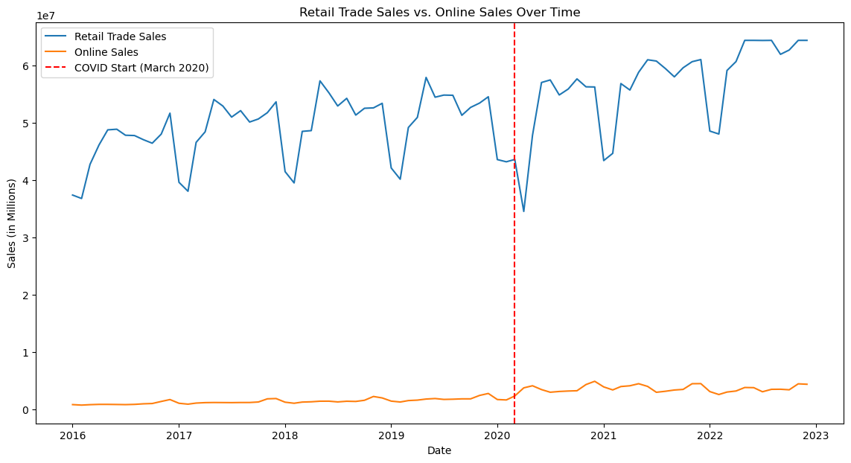
AN INDEPTH VIEW OF RETAIL VS ONLINE SALES OVER TIME (considering seasonality)

Slide 4
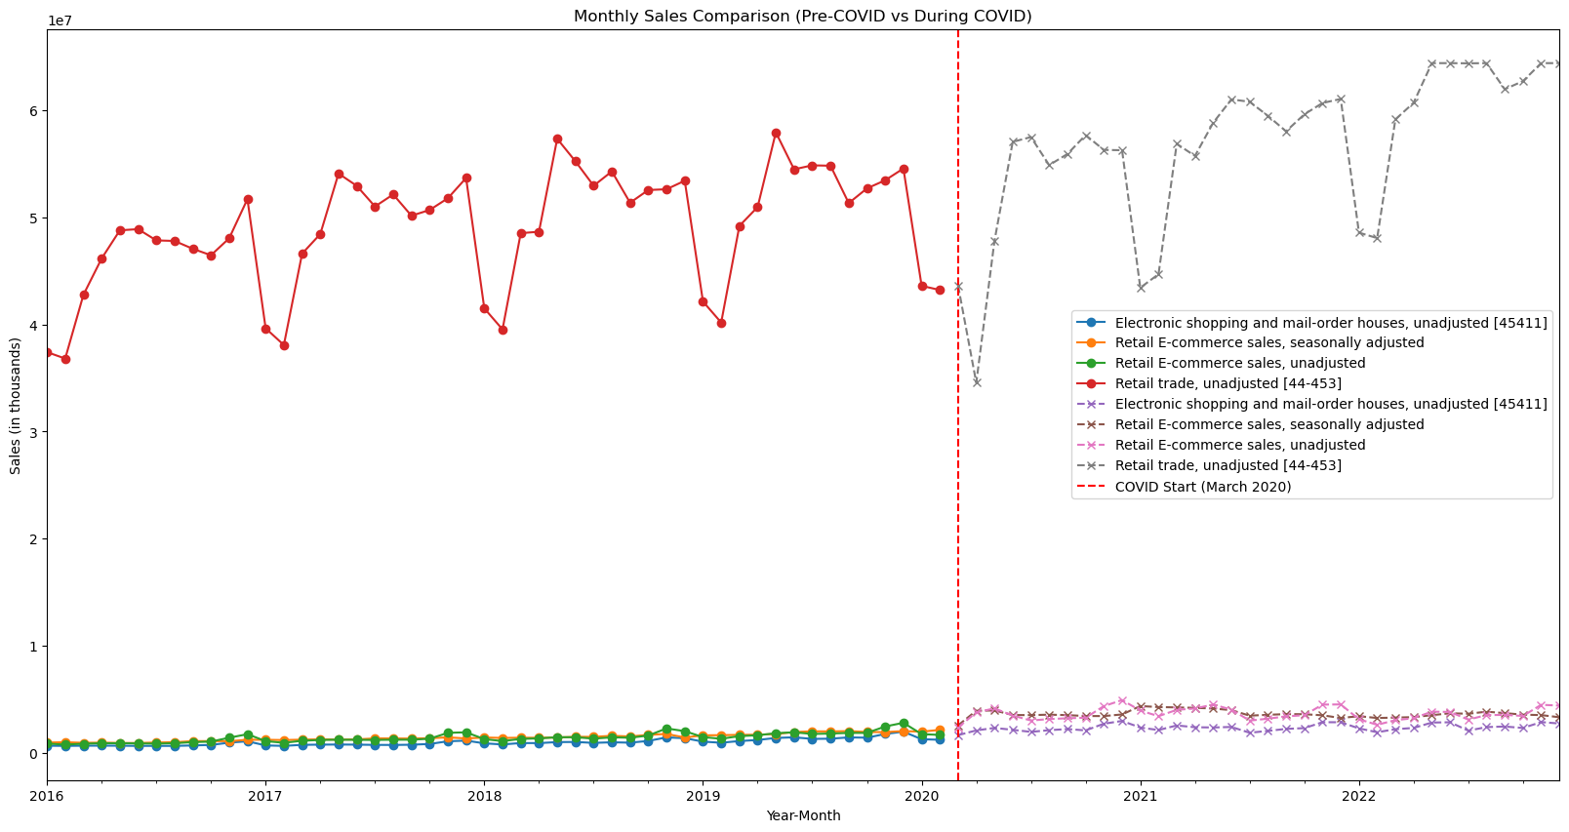
Pre and during covid monthly sales per category
In-store shopping decrease
E-com shopping increase

Slide 5
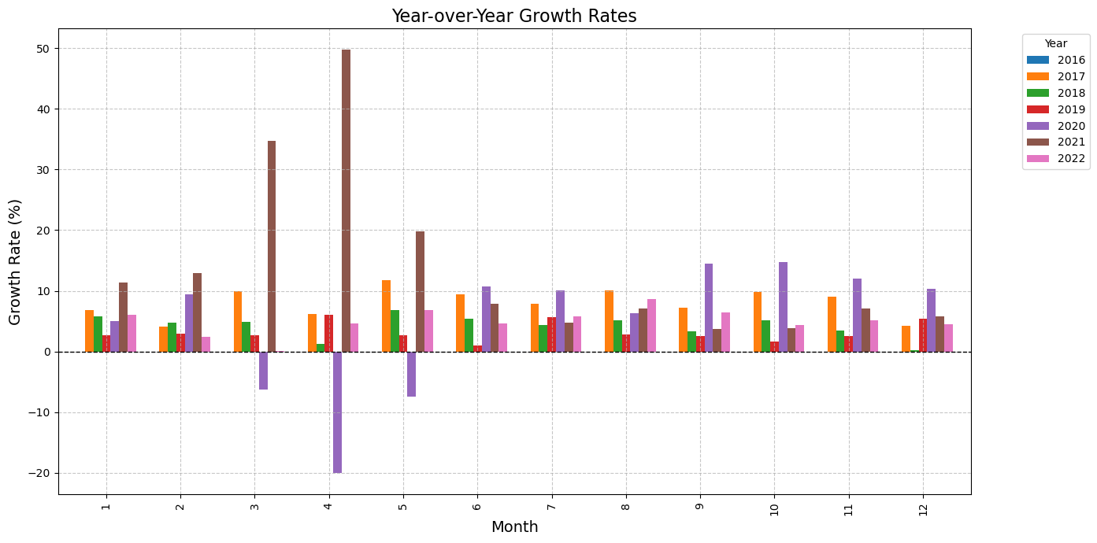
Year over year growth rates
Take a look at this !

Slide 6
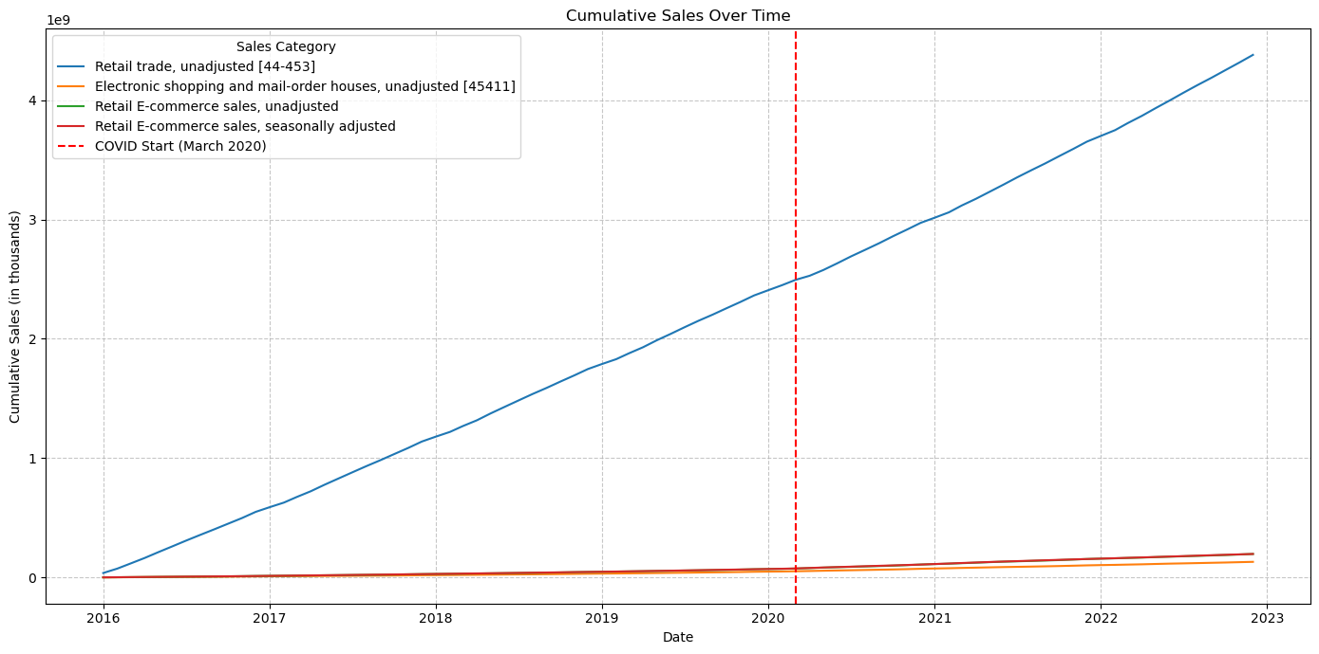
Cumulative sales over time - reflection

Slide 7
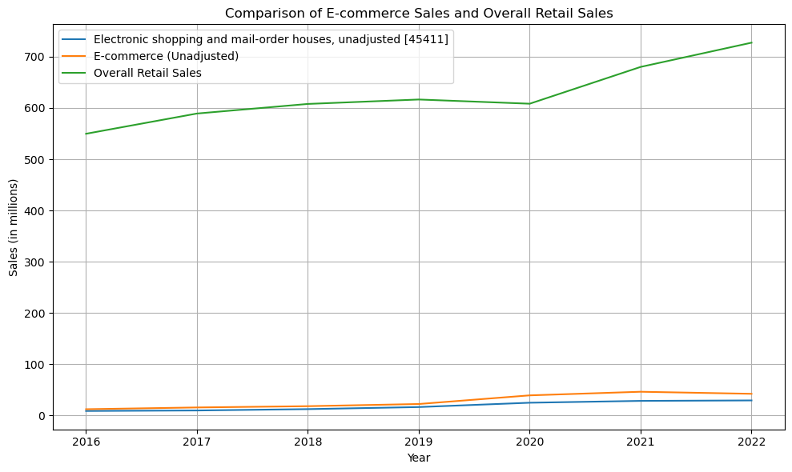
HOW DID RETAIL VS E-COM do PRE AND POST COVID IN CANADA

Slide 8
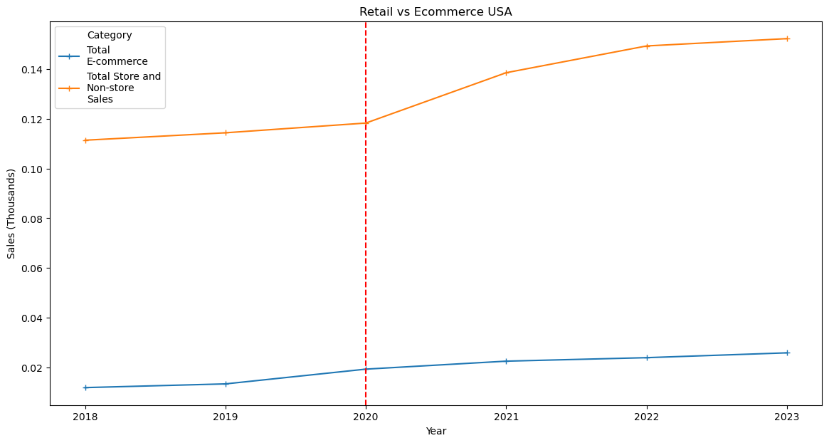
HOW DID RETAIL VS E-COM do PRE AND POST COVID IN THE US

Slide 9
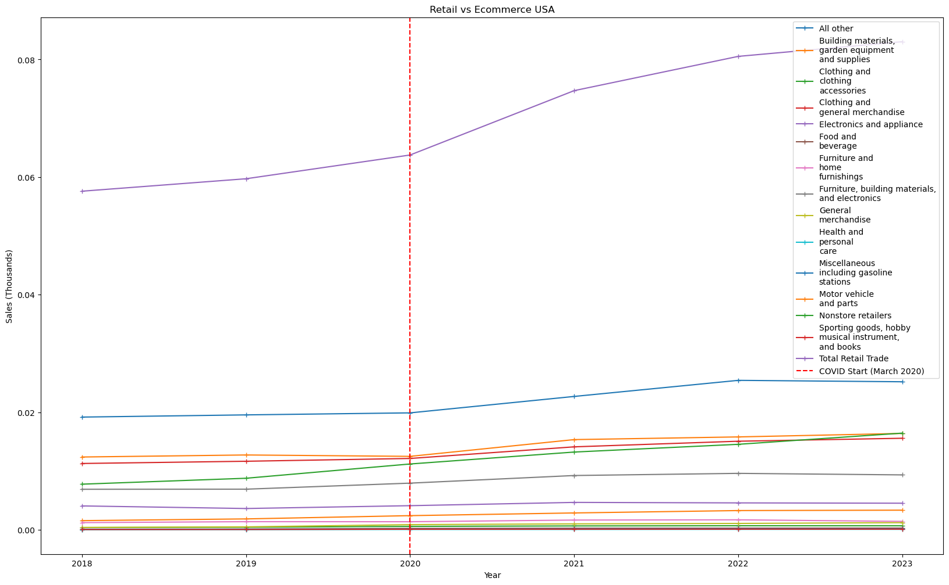
RETAIL VS E-COM IN THE US PER CATEGORY

Slide 10
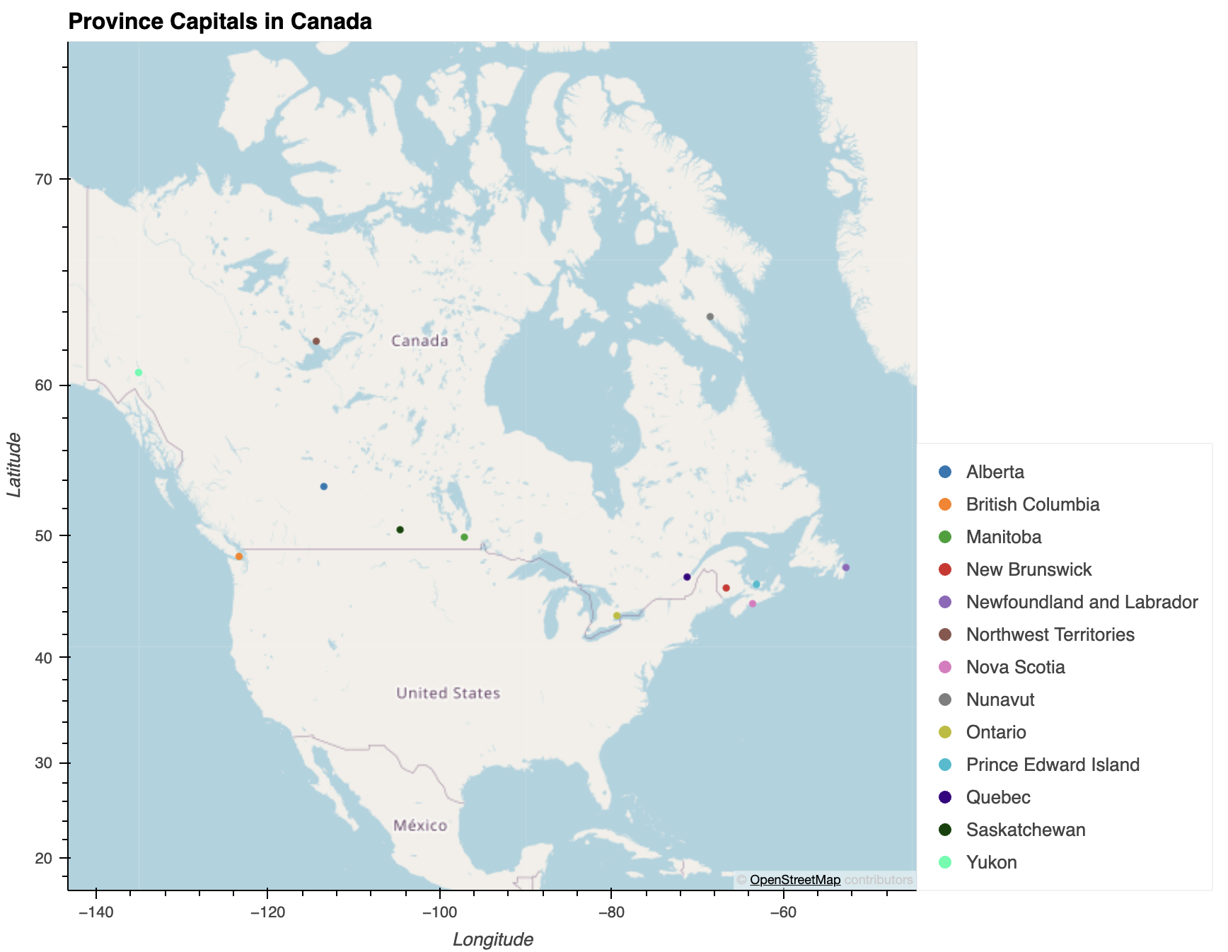
The map

Slide 11
conclusions
1. How has the COVID-19 pandemic affected the performance of e-commerce compared to traditional brick-and-mortar retail?
Physical retail stores saw a sharp decline in foot traffic and sales during the pandemic's peak, while e-commerce thrived. Pure e-commerce companies increased sales by 51%, hybrid companies by 74%, whereas pure brick-and-mortar stores experienced a (-1.3%) decrease in sales.
2. What are the long-term implications for consumer behavior in the retail industry?
We found that retail continues to play a significant role in the economy, contrary to the perception that online shopping would completely take over. Retail sales still lead significantly in comparison.
3. What were the most and least pandemic sensitive industry?
Electronics saw the greatest growth during the pandemic due to increased demand for home office and entertainment devices 48%. In contrast, the sports, music, and hobbies sectors were the hardest hit, with reduced spending due to restrictions on gatherings and activities (-96%).
4. API: Retail sales according to provinces in Canada
In 2022 Ontario had the most retail sales $112,258,393 and the least retail sales was recorded by Nunavut $242,232

